Slide 1
Number Systems
Week 5 Lab Excercise

Slide 2
Outline
Numerals Systems
Binary and Decimal Numbers
Conversion between Numeral Systems

Slide 3
The Decimal System
Characteristics
A positional number system
Has 10 symbols or digits (0, 1, 2, 3, 4, 5, 6, 7, 8, 9).
Hence, its base = 10
The maximum value of a single digit is 9 (one less than the value of the base)
Each position of a digit represents a specific power of the base (10)
Notes:
In everyday life we use a system based on decimal digits (0, 1, 2, 3, 4, 5, 6, 7, 8, 9) to
represent numbers, and refer to the system as the decimal system. Consider what
the number 83 means. It means eight tens plus three:
83 = (8 * 10) + 3
The number 4728 means four thousands, seven hundreds, two tens, plus eight:
4728 = (4 * 1000) + (7 * 100) + (2 * 10) + 8
The decimal system is said to have a base, or radix, of 10. This means that each digit
in the number is multiplied by 10 raised to a power corresponding to that digit’s
position:
83 = (8 * 10¹) + (3 * 10⁰)
4728 = (4 * 10³) + (7 * 10²) + (2 * 10¹) + (8 * 10⁰)

Slide 4
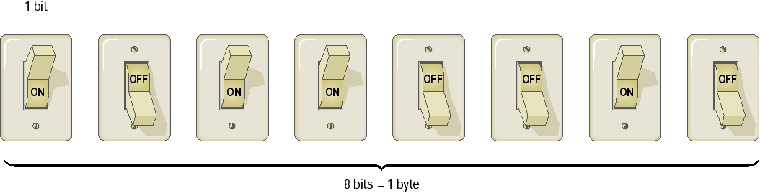
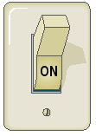
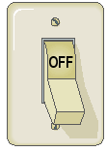
Binary Numeral System
Binary numbers are represented by the sequence of bits (smallest unit of information – 0 or 1)
Bits are easy to represent in electronics
1 0 0 1 0 0 1 0
1 0 0 1 0 0 1 1
1 0 1 1 0 0 1 0
1 1 1 1 1 1 1 1

Slide 5
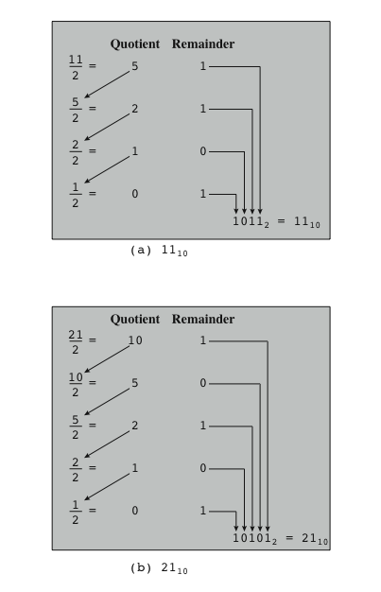
Converting Between Binary and Decimal
Examples of Converting from Decimal Notation to Binary Notation for Integers
Notes:
Figure 9.1. Examples of converting from decimal notation to binary notation for integers.

Slide 6

Decimal to Binary Conversion
Divide by 2 and append the remainders in reversed order:
500/2 = 250 (0)
250/2 = 125 (0)
125/2 = 62 (1)
62/2 = 31 (0) 500_{d} = 111110100_{b}
31/2 = 15 (1) 500₁₀ = 111110100₂
15/2 = 7 (1)
7/2 = 3 (1)
3/2 = 1 (1)
1/2 = 0 (1)

Slide 7
Practice Exercise
Convert from decimal to binary format
21
34
45
67
169

Slide 8

Convert Base 2 to decimal
Binary numbers (base 2)
Represented by 2 numerals: 0 and 1
Each position represents a power of 2:
101_{b} = 1*2² + 0*2¹ + 1*2⁰
= 5
110_{b} = 1*2² + 1*2¹ + 0*2⁰
= 6
110101_{b} = 1*2⁵ + 1*2⁴ + 0*2³ + 1*2² + 0*2¹ + 1*2⁰
= 32 + 16 + 4 + 1 = 53

Slide 9
Practice Exercise
Convert from binary to decimal format
00011000
00100101
00110001
01011001
11101011

Slide 10
Useful Resource
https://www.rapidtables.com/convert/number/decimal-to-binary.html

